Slide 1
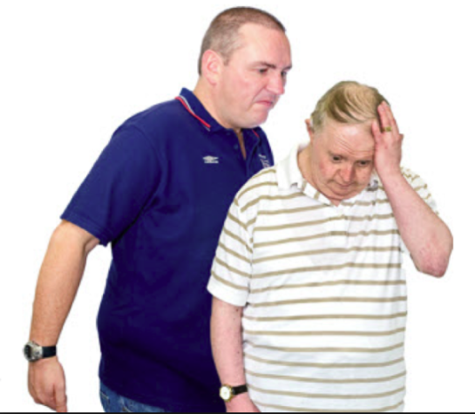
Feedback from people with learning disabilities
Hate Incident Reporting and Community Safety Team Awareness
Image

Slide 2
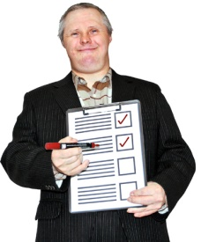
What works well
People who reported to the Community Safety Team were happy with the support they got.
Everyone said they would speak up they were scared by someone.
Image

Slide 3
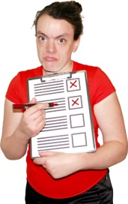
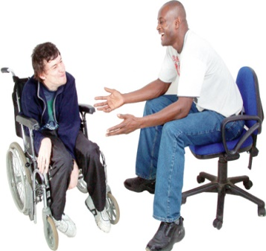
Issue 1
Most people would tell someone close to them.
Image
Easy read information about hate crime reporting needs to go to staff, carers and families.

Slide 4
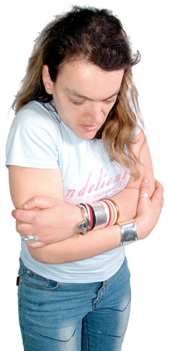
Issue 2
Some people do not trust staff and services.
They are scared that speaking up will make life difficult.
They need to know it will be confidential

Slide 5
Issue 3
Most people know how to contact the police.
No one knew how to contact the Community Safety Team.
Make it clear who to contact if you are a victim of hate crime.
Image

Slide 6
Issue 4
Most people do not use the internet.
They thought the leaflets were hard to understand.
Provide a new easy read leaflet with a clear phone number.
Image

Slide 7
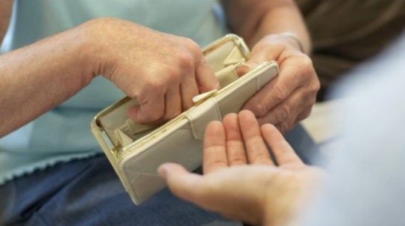
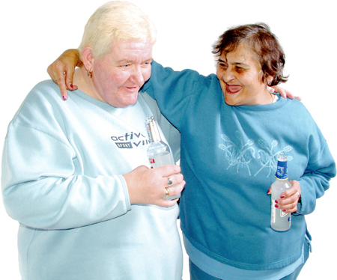
Issue 5
People have reported Mate Crime from other people with learning disabilities.
Image
This can be people they have known for a long time.

Slide 8
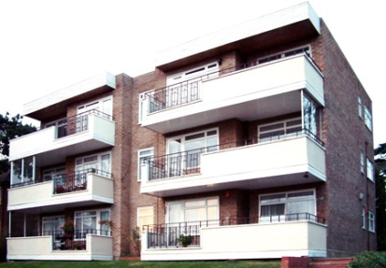
Issue 6
It is hard to know who a council tenant needs to report to.
Scheme managers need to know who to contact if they spot mate crime.
Image
Social workers and key workers need this information too.

Slide 9
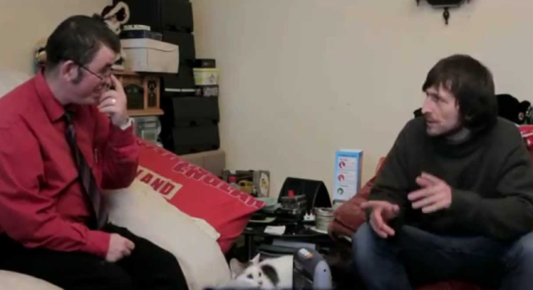
Issue 7
People want to tell the person who bullied them how it made them feel.
They want it to be safe.
Day services and staff should have training for this.

