Slide 1
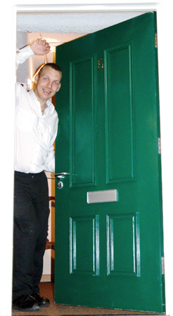
Feedback from people with learning disabilities
Image
On
Moving On

Slide 2
What worked well
People said their social worker knew them and understood them.
Most people were given plenty of choices.
Most people are happy in their new home.
Image

Slide 3
Issue 1
It is hard to understand jargon such as ‘Needs Assessment’ and ‘Visual Plan’.
Image
Use simple language to explain what is happening.

Slide 4
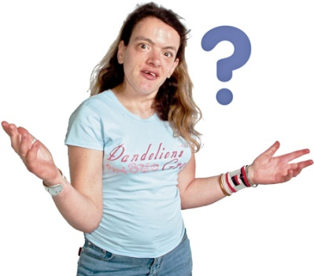
Issue 2
People find being rushed very stressful. It is hard to make decisions when you are under pressure.
Image
Do not tell people that they must move quickly or urgently.

Slide 5
Issue 2
Image
“I get stressed if I’m rushed.
I get angry.”
“I felt like that when I moved.”

Slide 6
Issue 3
People without family support find it harder to move their belongings and settle in.
Image
Take this into account and provide extra support for people who don’t have family to help them.

Slide 7
Issue 4
Some people find new places and people very distressing. It can be very difficult to get used to.
Image
Make sure that extra support is available for some time after the move.

Slide 8
Issue 4
Image
“ It is very difficult for people with autism. It is stressful to be in new situations.”

Slide 9
Issue 5
In house support is more reliable than outreach support. People feel ‘forgotten’ when they move.
Image
Ensure that support workers put people first if they have moved to live more independently

