Slide 1
Skin Cancer and Sun Safety Carolyn Phelps
Speak Up Against Cancer

Slide 2
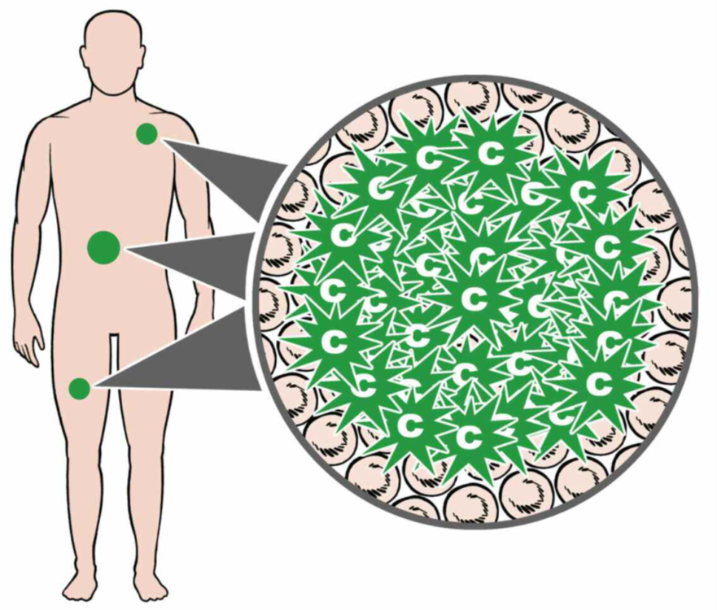
What is cancer?

Slide 3
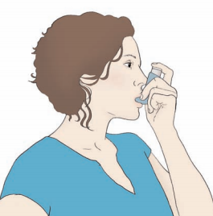
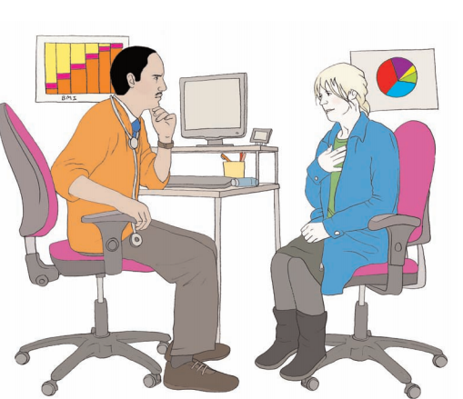
What If?
What would you do if you had a bad cold?
What would do if you your cold did not get better?
When we are ill and it doesn’t get better, we need to go to the doctor
Cancer is an illness that needs a doctor to help it get better

Slide 4
Speak Up Against cancer
Lets look at Skin cancer

Slide 5
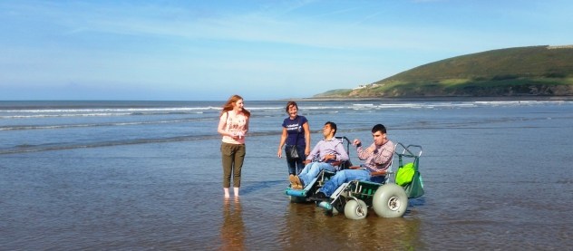
Being in the sun
When the sun shines it can feel great! Where do you like to go
Do you like the beach?
Or the park?
Or the garden?
Playing football or cricket?
This presentation will help you enjoy the sun safely!

Slide 6
The Sun
Why are we careful in the sun?
The sun gives out ultraviolet rays (UV rays).
These can damage your skin.
Too much sun is the main cause of skin cancer.

Slide 7
Sun beds
What else can harm your skin?
Sun beds give out ultraviolet rays (UV rays).
The rays can damage your skin.
Try not to use sun beds.

Slide 8
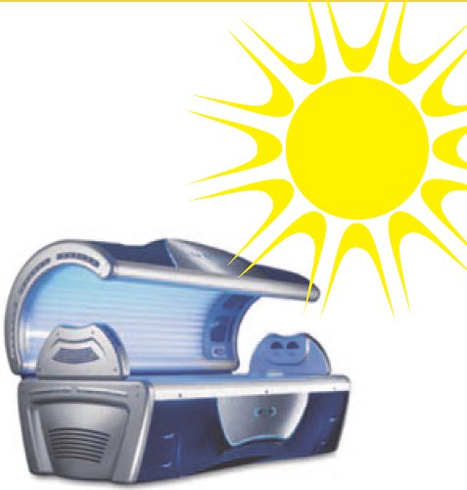
What causes skin cancer?
Skin can get damaged by too much sun and by sun beds.
When the cells in your skin are damaged it can cause cancer.

Slide 9
What should I look for?
Know how your skin usually looks, so that it is easier to notice anything unusual or changes that last.
A change to a mole, freckle or normal patch of skin.
A mole or growth that bleeds, crusts or scabs.
You can ask a friend, carer or family member to help you.

Slide 10
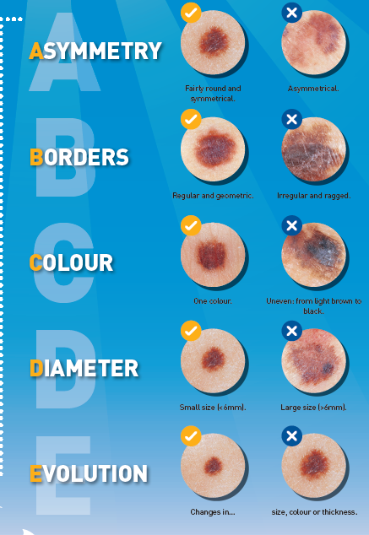
Moles
Moles are small, coloured spots on the skin.
You can ask a friend, carer, family or staff member to help check your skin.

Slide 11
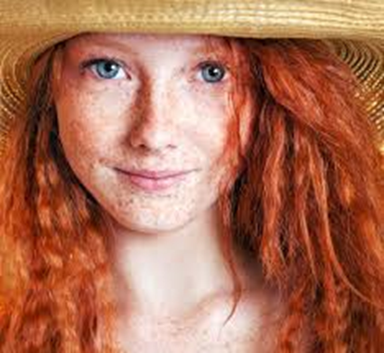
Sun safety
Skin Cancer - who is most at risk?
A family history of skin cancer
Fair skin that burns easily
Lots of moles or freckles
Red or fair hair
Light-coloured eyes
A history of sunburn

Slide 12
Speak Up Against Cancer
Let look at how to stay safe in the sun

Slide 13
Sun Safety

Slide 14
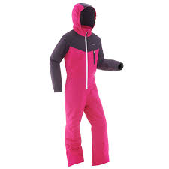
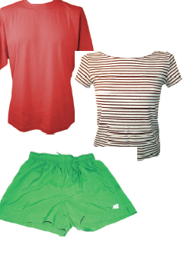
Cover up!
Cotton shorts and shirts are great things to wear if you are wearing sun cream!
You don’t need to cover up everything!

Slide 15
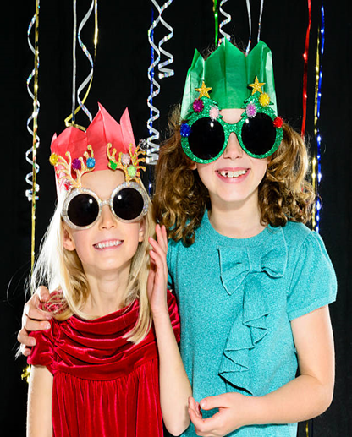
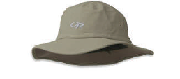
Cover your head!
A hat with a solid top and a nice wide brim helps keep the sun off your head and face
That’s not a sun hat!

Slide 16
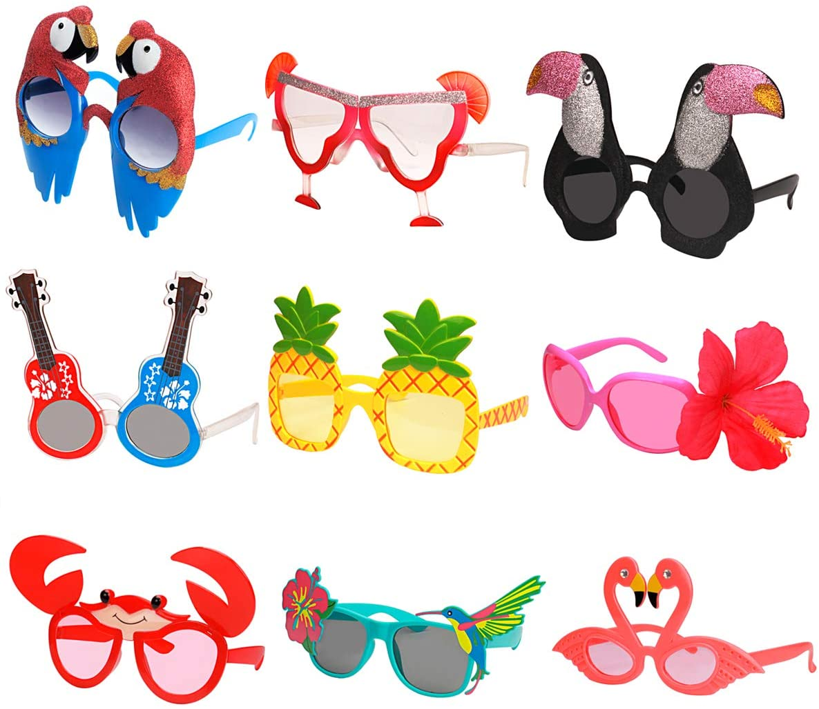
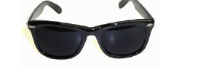
Shade your eyes
Sun glasses have darker lenses and they help protect your eyes
Fancy dress is fun but it doesn’t stop the sun!

Slide 17
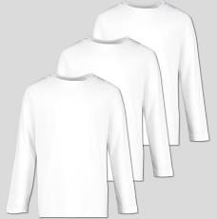
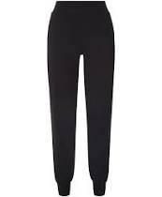
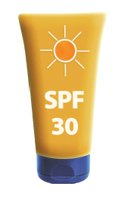
Cover up!

Slide 18
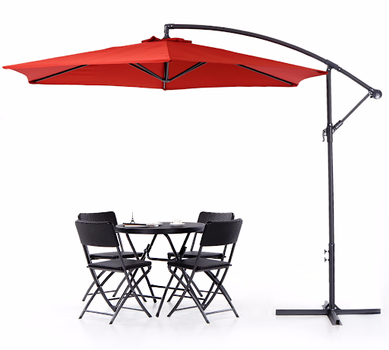
Find Shade!
Notes:
Wearing a hat, long sleeved top, sunglasses when the sun is out

Slide 19
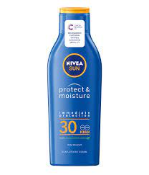
Sun creams- UVA and UVB

Slide 20
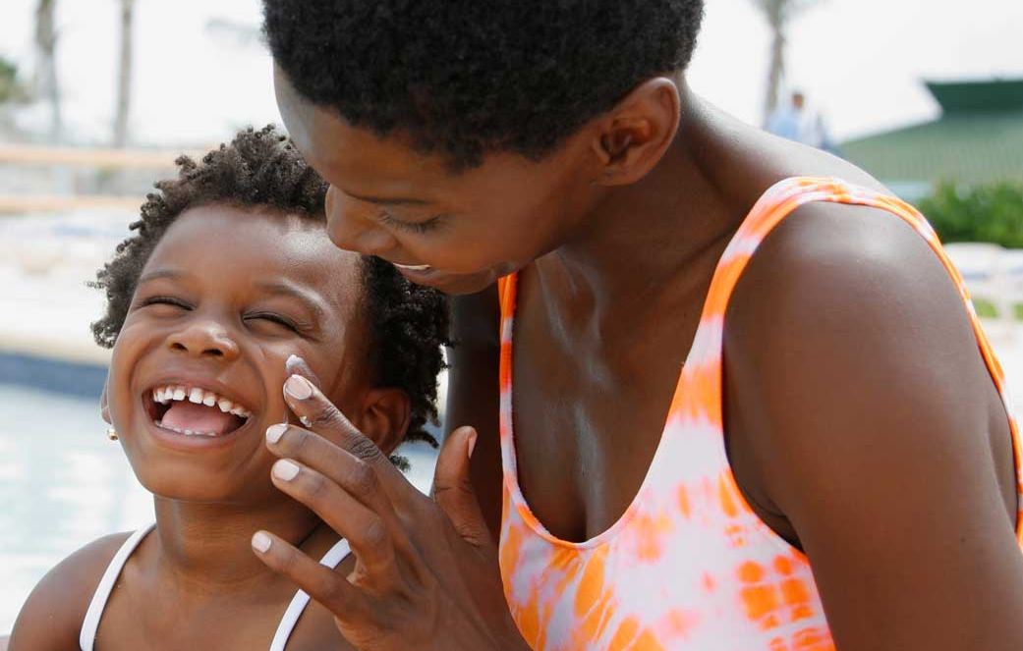
Skin protection- Sun cream
Put sun cream on your skin.
Use sun cream that is factor 30 or more.
Ask for help to choose your sun cream.
Ask for help to put on your sun cream, or cover up.

Slide 21
Recap
Stay safe in the sun and have fun
Use sun cream
Chill out in the shade
Cover up with clothing
Enjoy!
But if something on your skin looks different –
tell someone who can help.

