Slide 1
The impact of the COVID-19 pandemic on people with learning disabilities
KCL Learning Disability Services Series
14th June 2022
Professor Chris Hatton
Dept of Social Care and Social Work
Manchester Metropolitan University, UK

Slide 2
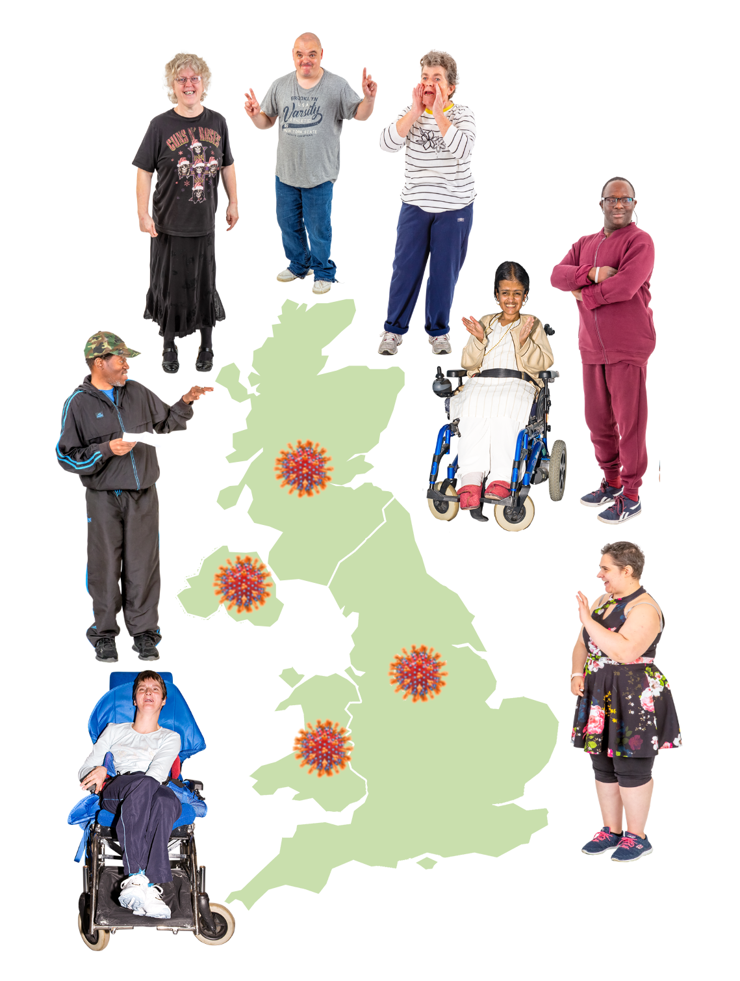
People with learning disabilities and the COVID-19 pandemic – peaks and consequences
Trying to track the impact of the pandemic
What next?

Slide 3
People with learning disabilities and the COVID-19 pandemic – peaks and consequences

Slide 4
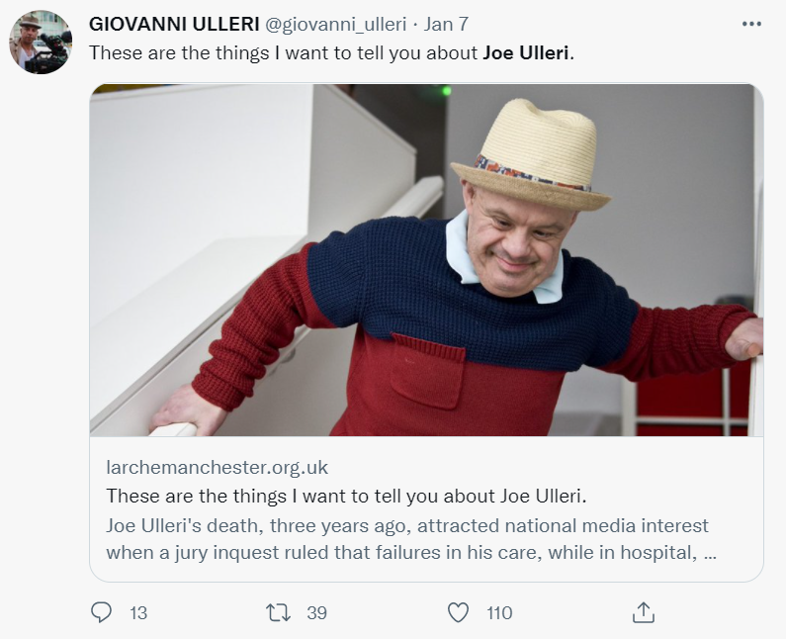
Coming into the pandemic…
People with learning disabilities dying 15-20 years earlier than other people, with the gap not closing
Pervasive socio-economic inequalities, throughout people ‘s lives, made worse by austerity
Continuing evidence of institutional discrimination in specialist and mainstream health services

Slide 5
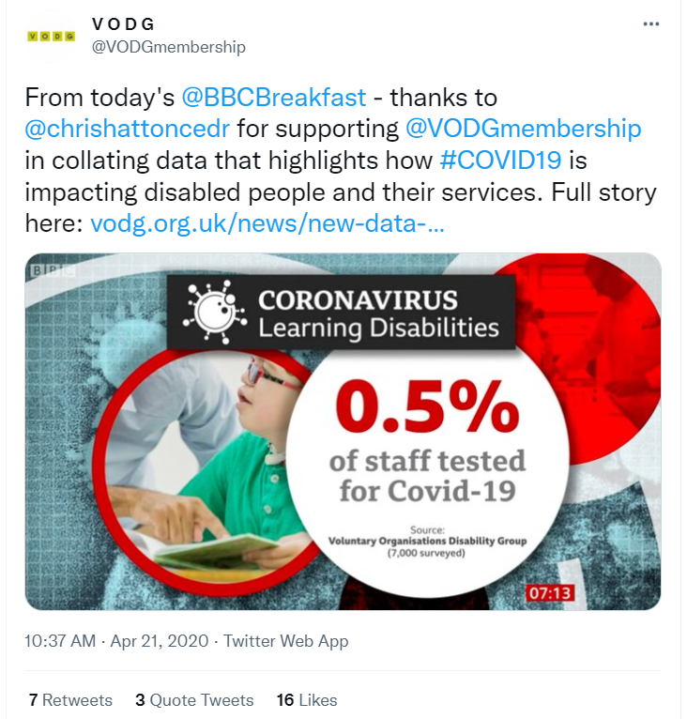
As the pandemic hit…
Complete lack of pre-pandemic planning or even awareness of people with learning disabilities
No PPE
No testing
No guidance
No support for families
Withdrawal of social care services
‘Easement’ of legal duties

Slide 6
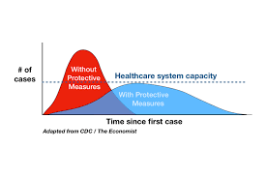
As the pandemic hit…
COVID-19 risk viewed in terms of specific lists of medical ‘conditions’
‘Underlying health conditions’
‘The vulnerable’
Little consideration of multiple health conditions or social and economic conditions putting people at risk
‘Flattening the curve’
Implicit herd immunity strategy
Late introduction of public health protection measures, including lockdown

Slide 7
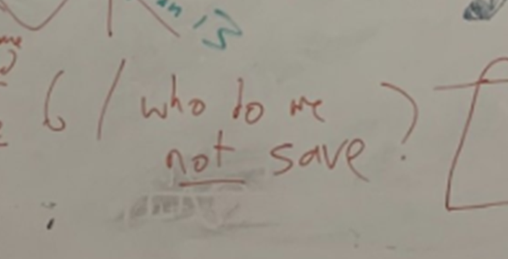
As the pandemic hit…
‘Protect the NHS’
Health service priority was hospital capacity for treating and managing COVID-19
Diversion of health professionals and resources from other health services – ongoing therapies stopped
Institutional discrimination in health service responses to people with learning disabilities: DNARs and NICE guidelines

Slide 8
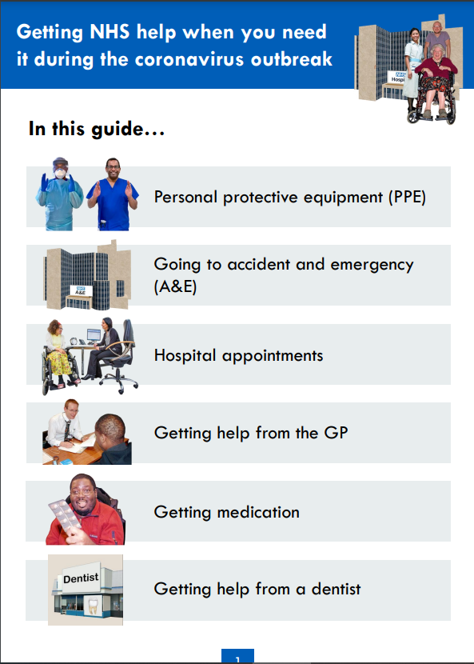
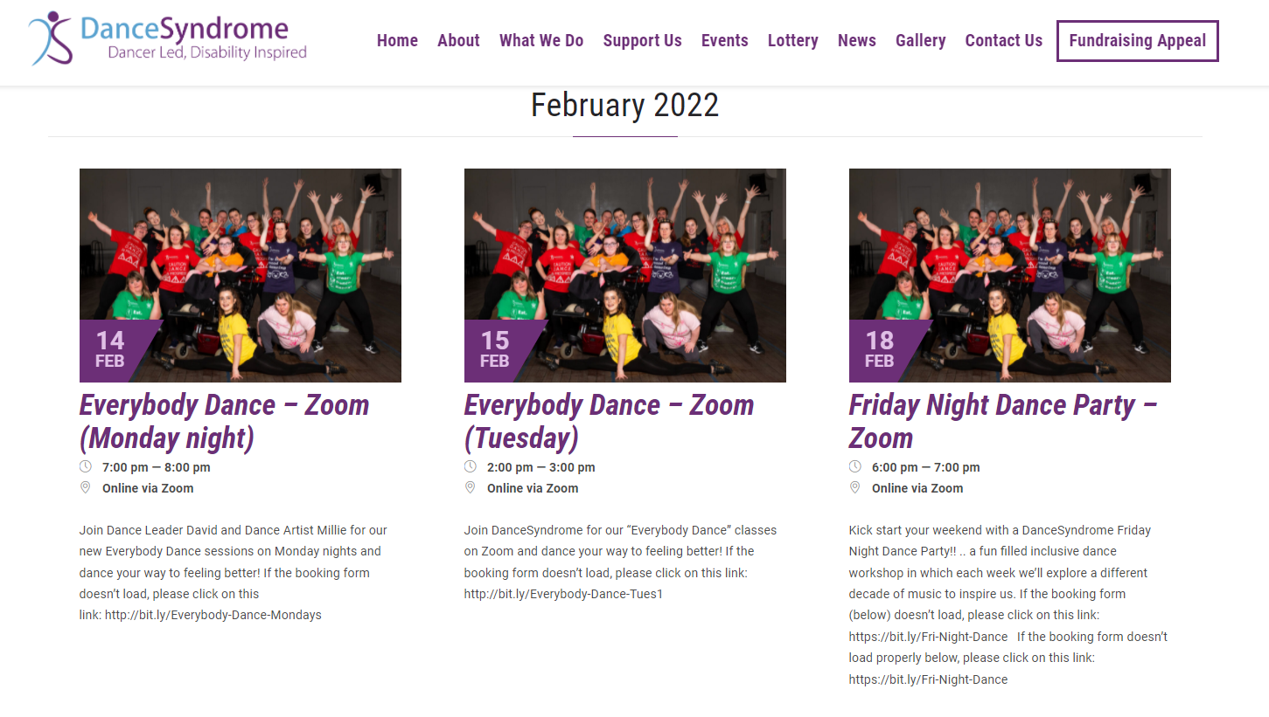
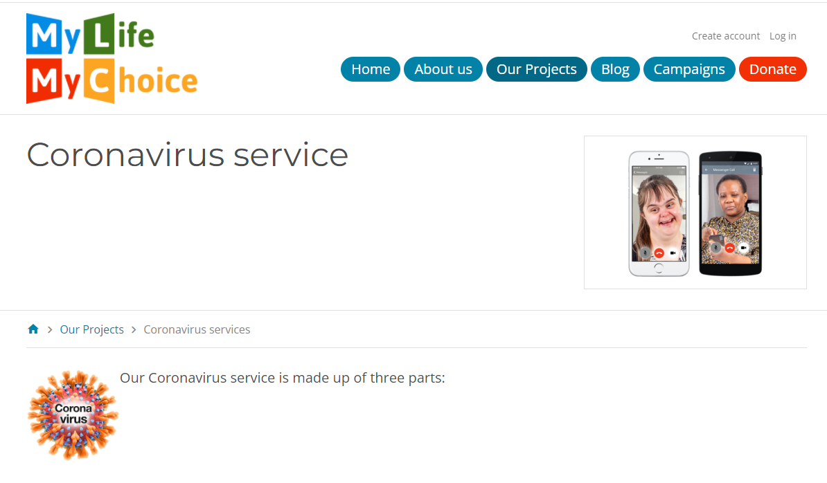
Who stepped into the void? Disabled people’s organisations

Slide 9
The consequences – infections and deaths
In the first two peaks of the pandemic, people with learning disabilities were:
Twice as likely to get COVID-19 (Henderson et al, 2021, in press)
Between three and six times more likely to die of COVID-19 (Henderson et al, 2021; PHE, 2020; ONS, 2021)
More likely to die from COVID-19 at younger ages than other people
This increased risk might be reducing over time and with vaccinations
Living in a place with a lot of other people puts people with learning disabilities at higher risk from COVID-19 (PHE, 2020; ONS, 2021)
Likely that over 2,700 people with learning disabilities in England have died of COVID-19 so far

Slide 10
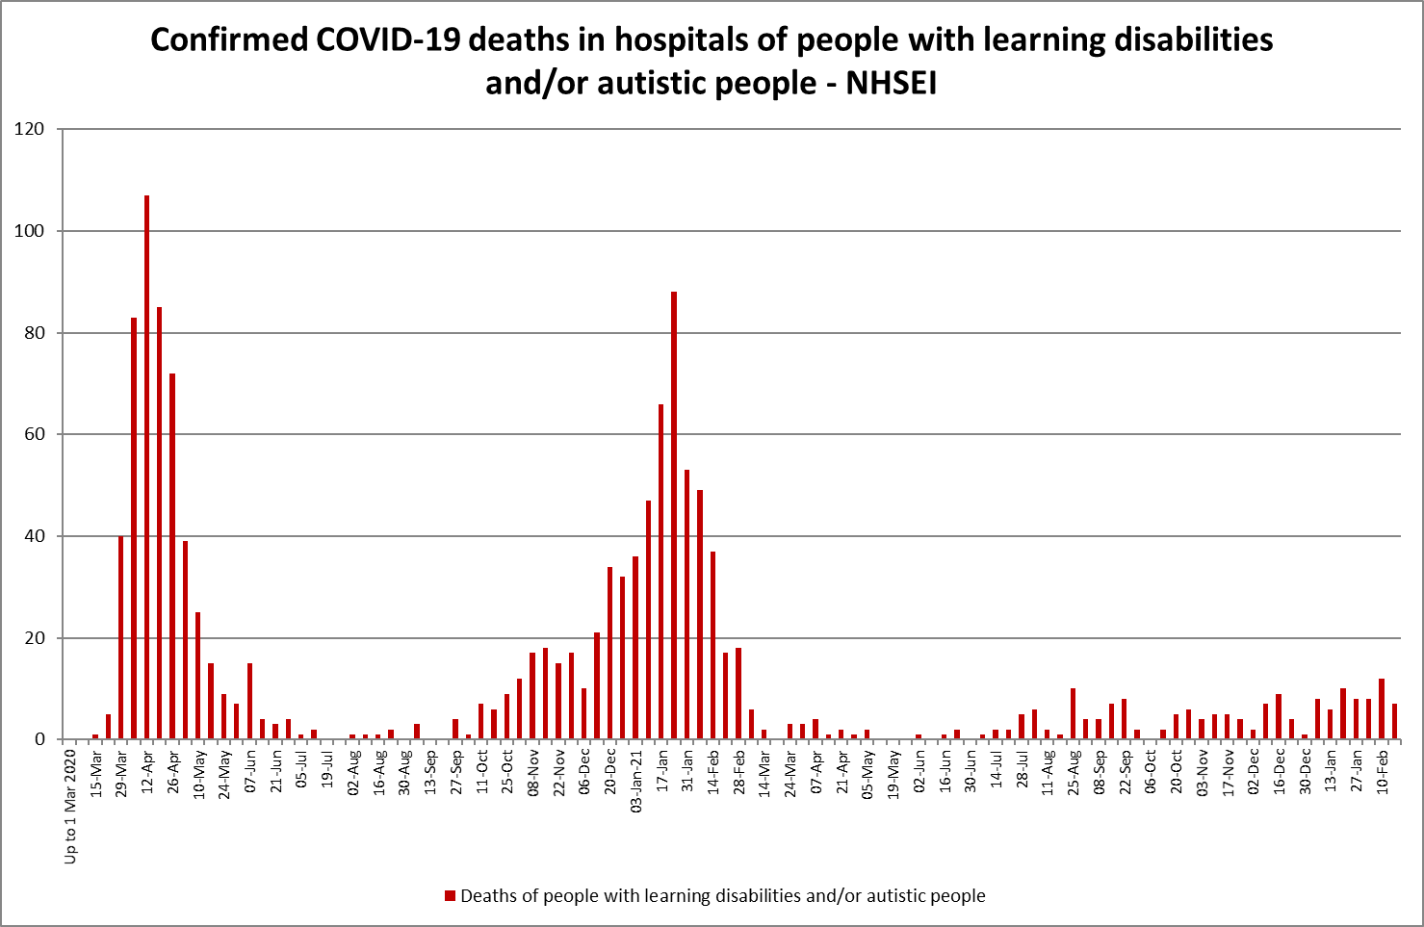

Slide 11
Vaccination: a relative success?
COVID-19 vaccination rates with at least one dose now high (90% plus) for most groups of adults with learning disabilities
COVID-19 booster vaccination rates around 80% for older and shielding adults with learning disabilities
Still lower for younger age groups and for people from minority ethnic communities (OpenSafely, 2022)
Vaccination for children and young people?
Fourth dose boosters?

Slide 14
2) Trying to track the impact of the pandemic

Slide 15
Tracking the impact of the pandemic – social care statistics
1,500 fewer adults with learning disabilities getting long-term social care in England at the end of March 2021 compared to the end of March 2020 (NHS Digital, 2021)

Slide 16
Tracking the impact of the pandemic – social care statistics
1,055 fewer adults with learning disabilities aged 18-64 in settled housing with family/friends in England in 2020/21 vs 2019/20 (NHS Digital, 2021)

Slide 17
Tracking the impact of the pandemic: The Coronavirus and people with learning disabilities project
https://warwick.ac.uk/fac/soc/cedar/covid19-learningdisability

Slide 18
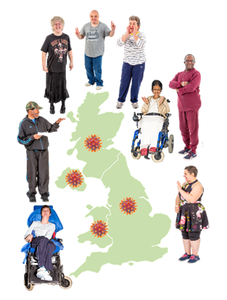
The project
Trying to track people’s experiences, circumstances, and support throughout the pandemic
Trying to make sure questions are relevant to policy-makers, groups of people with learning disabilities, family members, across the UK
Trying to get information public quickly for multiple groups of people to use
Project website https://warwick.ac.uk/fac/soc/cedar/covid19-learningdisability

Slide 19
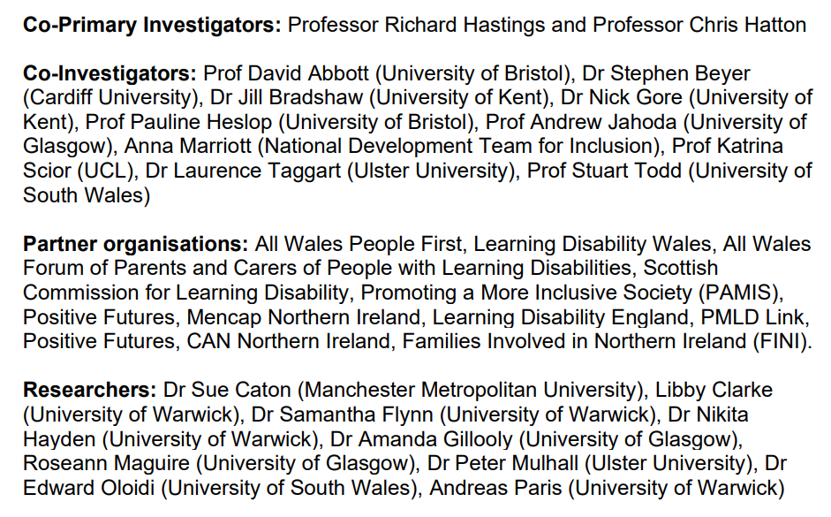

Slide 21
Disclaimer
This research was funded by UK Research and Innovation (Medical Research Council), and supported by the Department for Health and Social Care (National Institute for Health Research) as part of the UKRI-DHSC COVID-19 Rapid Response Rolling Call.
UKRI: MR/V028596/1
NIHR: COV0196
This presentation summarises independent research funded by the Department for Health and Social Care (DHSC) (National Institute for Health Research; NIHR) and UK Research and Innovation (UKRI) (Medical Research Council; MRC). The views expressed in this presentation are those of the author(s) and not necessarily those of DHSC, NIHR, UKRI or MRC.

Slide 22
The Coronavirus and people with learning disabilities project
Cohort 1 - Zoom/phone interviews with adults with learning disabilities (approx. 500 people at Wave 3)
Cohort 2 - Online surveys for family members/support workers about adults with learning disabilities with greater needs who could not take part in an interview (approx. 300 people at Wave 3)
People and families interviewed/surveyed 3 times:
Wave 1 - December 2020 - February 2021 (largely lockdown)
Wave 2 - April – May 2021 (restrictions easing)
Wave 3 - July – August 2021 (most restrictions removed)

Slide 23
People are doing their bit to keep themselves and others safe
By July/August 2021
More than 9 out of 10 people had both doses of the COVID-19 vaccine, and would have a booster
People had been following the rules with lockdowns and public health protection measures (not going out; wearing facemasks; testing etc)
For at least half of people, family carers/support workers were using some form of PPE when in close contact
I asked a chemist how to do it [A lateral flow test]. I made a video of how to do it for people with learning disabilities to go on our website. It tickled the nose and you have a timer. It’s easy.

Slide 24
People are paying a price for this
By July/August 2021
Half of people were worried about leaving the house
Over 2 out of 10 people were often/always worried or anxious
At least 2 out of 10 people had had a new or worsening health problem in the last month
2 out of 10 people with a paid job before the pandemic had lost their job
Over half of family carers/support workers reported general feelings of stress, tiredness, disturbed sleep

Slide 25
Worries about the pandemic – Cohort 1 (UK)

Slide 26
Effect of caring role on family/paid carers in last 4 weeks – Cohort 2 (UK)

Slide 27
Service support has not gone back to normal
By July/August 2021
Contact with health professionals (GP, annual health checks, therapists) and social care services was not back to the levels they were before the pandemic
Some service support had shifted towards online and away from face-to-face support
Support was returning more slowly for people with greater needs
Waiting list times for planned medical tests, hospital appointment or operations were increasing
For around 4 out of 10 people, the person or their family were paying for some services out of their own pockets

Slide 28
Have you been going to community activities? Cohort 1 (England)

Slide 29
Has the person you support/care for been going to a day service? Cohort 2 (England)

Slide 30
For some people, there have been some good things
Getting online and connecting with people
A more relaxed pace of life – not having to get up early and rush off somewhere
Spending more time with people who are close
Better contact with neighbours
Because we all had to go through the same thing. So, we did things to support each other. You have to help people, you just can't help yourself, you have to help others.

Slide 31
Lifting of public health protections generally means a much more restricted life for some people
Massive issue for people with greater support needs, particularly people with Profound and Multiple Learning Disabilities (PMLD)
2 out of 10 people with greater needs were still ‘shielding’ in July/August 2021
For over half of people with greater needs, a continuing restricted life was having a negative impact on the person
No ‘roadmap’ to how things will get better
Comparison – 13% of people considered to be clinically extremely vulnerable in England were still shielding in April 2022 (ONS, 2022)

Slide 32
Leaving the house in the last 7 days at Wave 3 - Cohort 1 vs Cohort 2 (UK)

Slide 33
The impact of COVID-19 is continuing
By July/August 2021
At least three quarters of people said their life would not get back to normal until 2022 or later, if ever
People said that everyone going back to facemasks and social distancing, and low numbers of people getting COVID-19 locally, would help them feel safe to go out
More than 8 out of 10 people with support staff wanted all their support staff to be COVID-19 vaccinated

Slide 34
What are you looking forward to when we can do more?
Kissing my girlfriend and being close, being back to work and going on transport and to the cinema and things like that
Don't know - just stay in
I don't even want to hope
Having a hug and being able to see us with no full PPE on. Being able to take him out to open spaces for walks and fresh air

Slide 35
3) What next?

Slide 36
Is the England/UK experience unusual?
International scoping review (Taggart et al., 2021)
“Limited availability and access to basic public health prevention and protection measures
Imposing lockdowns on people with intellectual and developmental disabilities and their carers has significantly impacted upon the person’s behavioural presentation and/or mental health as well as the well-being of family carers
Closures of schools, education, day-care, respite, community activities, and employment
Compulsory covert DNR orders placed upon this population
Restrictions of access to acute hospitals and lifesaving equipment
Violations of the rights to life of people with intellectual and developmental disabilities”

Slide 37
Implications for policy - England
Pathways Associates in NW England ran an online conference to discuss what should happen next
Learning Disability England and PMLD Link identified policy priorities, using findings from the project
Policy briefings for England produced
Short films commissioned by self advocacy groups, family members and support staff

Slide 38
Implications for policy - England
Links to policy briefings and short films collected here https://www.learningdisabilityengland.org.uk/welcome/work-with-members-and-partners/uk-covid-research/
Similar activities in each part of the UK https://warwick.ac.uk/fac/soc/cedar/covid19-learningdisability/results/policybriefing/

Slide 46
Four questions from Pathways Associates
What should services do for the many people and families who feel they have been forgotten and left behind through COVID-19?
What should services do for people and families who are still shielding or stuck inside – what is the path to a better future for them?
How can we build hope for ourselves?
How can services rebuild trust?

Slide 47
Martin Stevens

